Slide 1
Olist Store Data Analysis
Tool:Power BI

Slide 2
Datasets
Domain : E-Commerce
Project Name: Olist Store Analysis
Dataset Name: Total 9 files
Dataset Type: CSV Data
Dataset Zip Folder Size: 45 MB
This dataset, provided by Olist Store, the largest department store in the Brazilian marketplace, contains real commercial data of 100k orders made in the store from 2016 to 2018. The dataset includes various features that provide insights into multiple dimensions of the orders, such as order status, price, payment, sellers, freight performance, customer location, product attributes, and customer reviews.

Slide 3
KPI’s
Weekday Vs Weekend (order_purchase_timestamp) Payment Statistics
Number of Orders with review score 5 and payment type as credit card.
Average number of days taken for order_delivered_customer_date for pet_shop
Average price and payment values from customers of sao paulo city
Relationship between shipping days (order_delivered_customer_date - order_purchase_timestamp) Vs review scores.
Top 5 Product based on sales, and its Sales and Price Analysis
Top 5 States by sales
Is the shipping day affecting sales (Avg Shipping day Vs Sales)

Slide 4
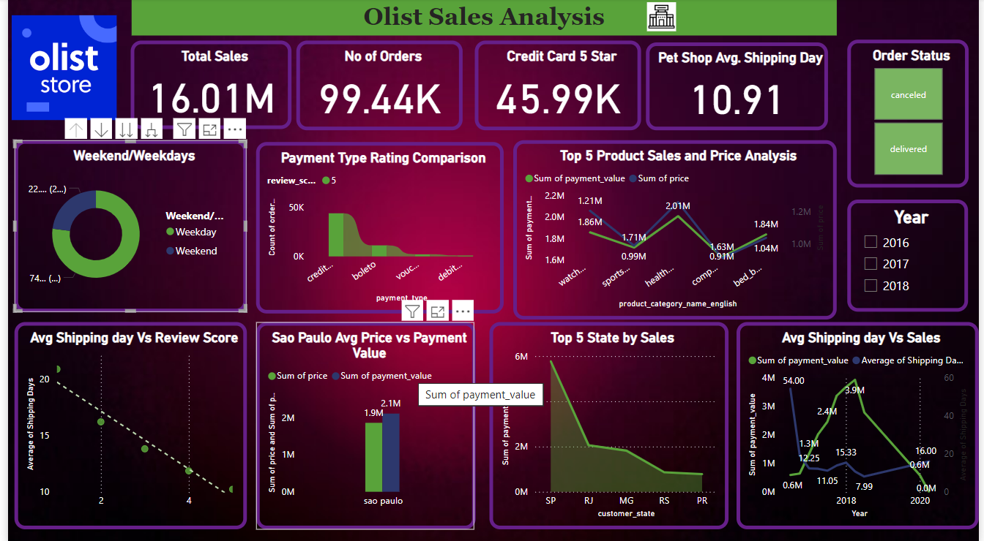
ModelView

Slide 5
Insights and Analysis:
Weekday vs. Weekend Payment Statistics:
The pie chart shows the distribution of orders between weekdays and weekends.
Weekdays have a higher share of orders (77%)compared to weekends(23%), indicating more customer activity during workdays.
Number of Orders with Review Score 5 and Payment Type as Credit Card:
The "Payment Type Rating Comparison" graph highlights the count of orders with various payment types.
Credit cards account for a significant portion of orders with a 5-star review score, suggesting customer satisfaction is associated with this payment method.
Average Number of Days Taken for Orders in Pet Shops:
The "Pet Shop Avg. Shipping Day" metric shows an average delivery time of 10.91 days for pet shop orders.
This delay may impact customer satisfaction, especially if faster delivery is expected for such items.
Sao Paulo City: Average Price and Payment Values:
The "Sao Paulo Avg Price vs Payment Value" bar chart shows the sum of price and payment values.
Sao Paulo has the highest customer payment contribution, with significant transaction volumes.
Relationship Between Shipping Days and Review Scores:
The scatter plot shows a negative correlation between average shipping days and review scores.
Faster deliveries are linked with higher review scores, emphasizing the importance of timely delivery.
Top 5 Products Based on Sales (Sales and Price Analysis):
The line graph highlights the top 5 products by sales and compares payment value and prices.
Products in categories like health and sports have significant sales, with varying pricing strategies impacting revenue.
Top 5 States by Sales:
The bar chart shows the distribution of sales across the top states.
São Paulo (SP) dominates sales, followed by Rio de Janeiro (RJ) and Minas Gerais (MG). Businesses should focus marketing efforts on these regions.
Impact of Shipping Days on Sales (Avg Shipping Day vs. Sales):
The line chart indicates that higher average shipping days correspond to a drop in sales.
Efficient shipping is crucial to maintain and improve sales volumes.

Slide 6
Recommendations:
Enhance Shipping Speed: Address the correlation between long shipping times and lower review scores to improve customer satisfaction and sales.
Focus on Key Regions: Prioritize marketing and operational strategies in states like SP and RJ, which contribute the most to sales.
Credit Card Incentives: Promote offers for credit card payments since they are linked to higher review scores.
Product Pricing Strategy: Analyze the pricing for top-performing product categories to maximize profit without deterring customers.
Weekend Engagement: Develop promotions and campaigns to increase weekend orders, balancing the weekday/weekend order disparity.

